Slide 1
Flask & ReactJS connection

Slide 2
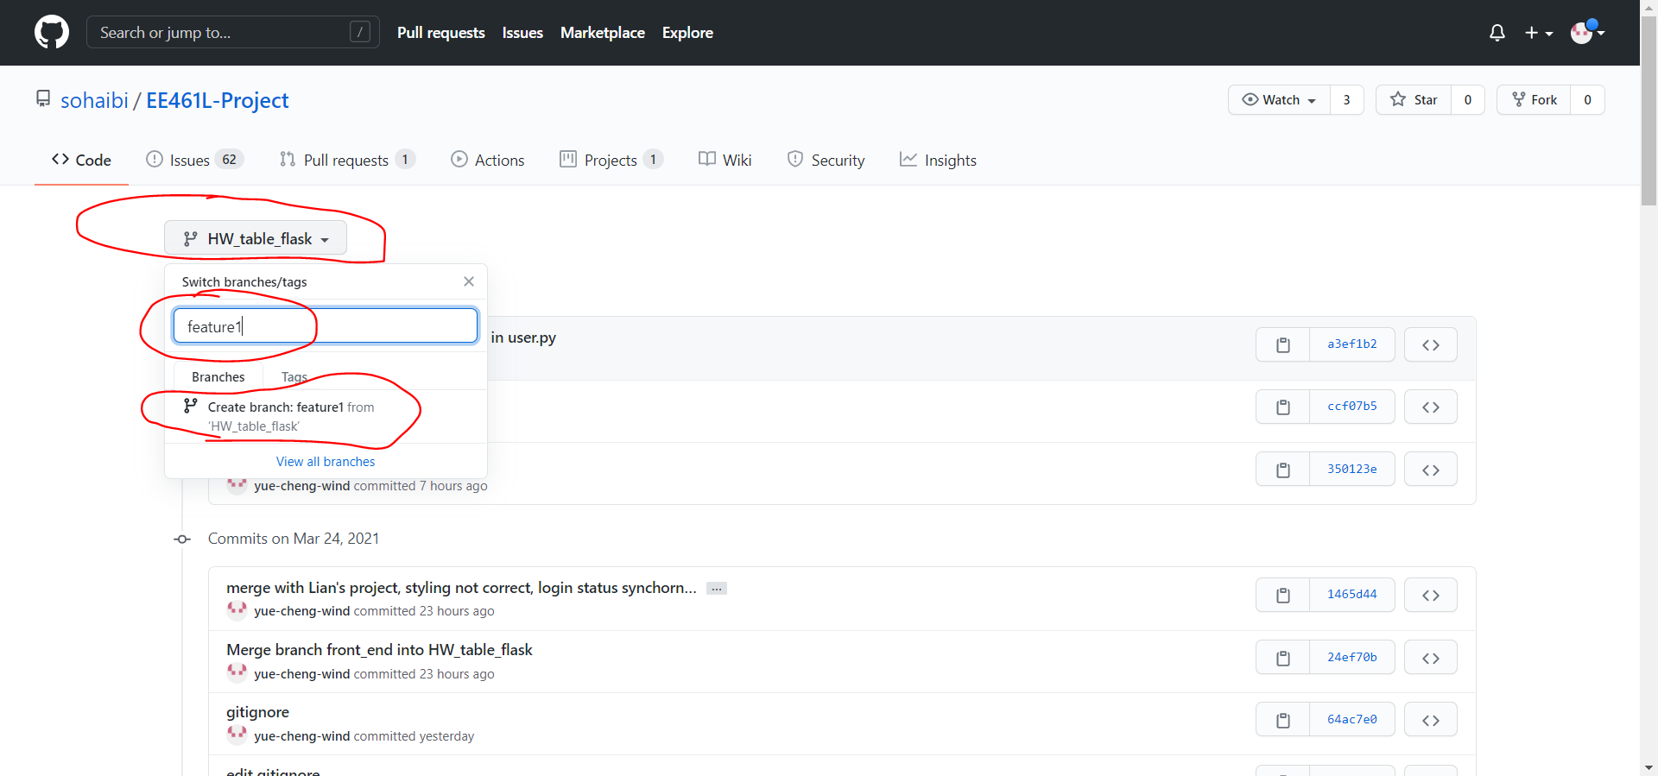
Steps:
On github, create a remote branch from the current HW_table_flask branch with the name you like, this new created branch will contain the same information from the ‘HW_table_flask‘ branch, which is from commit a3ef1b2
Reference only!

Slide 3
Steps:
2. In your local git repository, create your own local branch(usually with the same name) as the new remote branch, switch to it and connect them using command below:
$ git checkout -b <local_branch_name>
$ git push -u <remote_branch_name> <local_branch_name>
3. Under ‘EE461L- Project’ folder, activate your virtual environment:
$ python3 -m venv .venv
$ source .venv/bin/activate # or source .venv/Scripts/activate in
# Windows
4. In the same folder, Install all the dependency in requirements.txt:
$ pip install -r requirements.txt
5. In ‘EE461L- Project/FrontEnd’ folder, delete package-lock.json file and the node_modules directory(if you don’t have it, just ignore) by doing
$ rm -r package-lock.json node_modules # or you can delete them mannually
6. In ‘EE461L- Project/FrontEnd’ folder, run
$ npm install # now you should be good to go

Slide 4
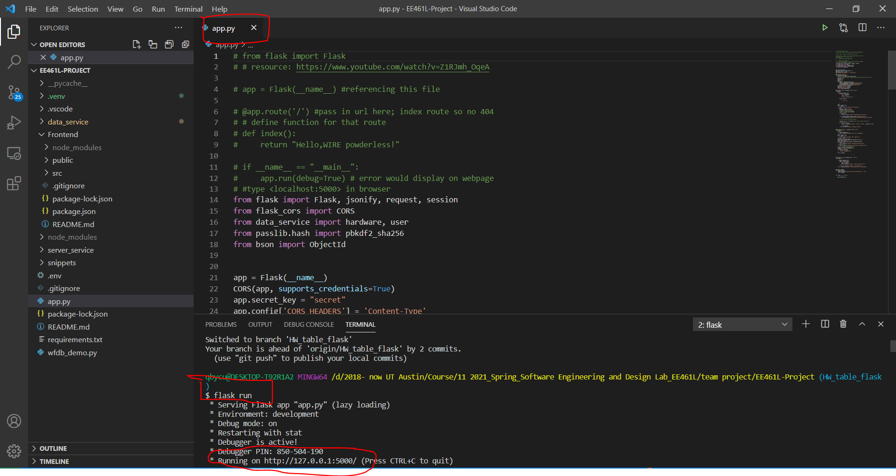
Run Flask
Under ‘EE461L-Project’ folder, do ‘flask run’
- It will automatically execute the file ‘app.py’ under ‘EE461L-Project’ folder. Keep this terminal running.

Slide 5
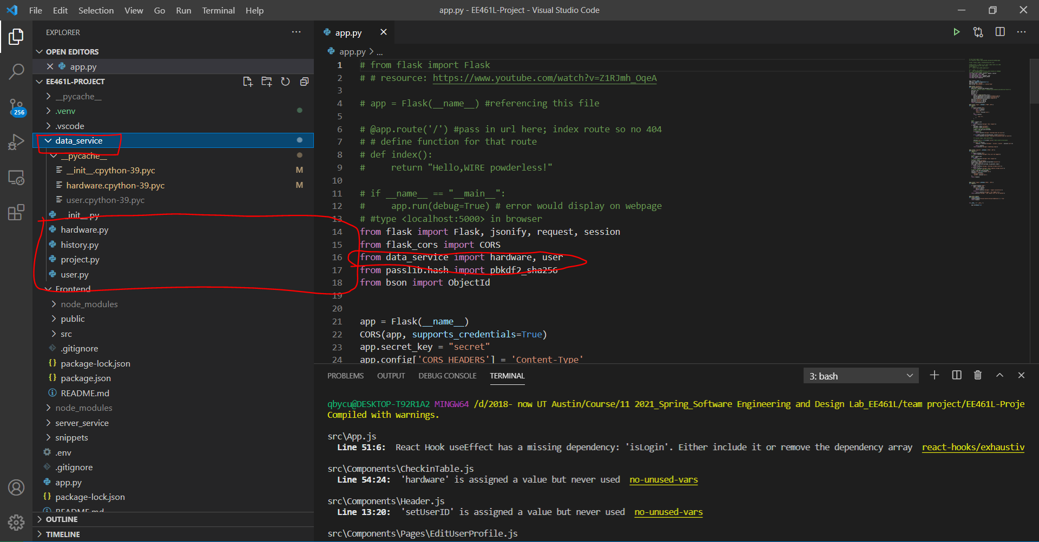
How Flask can modify the mongoDB data
In app.py, import the *.py file from the ‘data_service’ package, in which the backend people wrote methods to modify/read the data we have in mongoDB database.

Slide 6
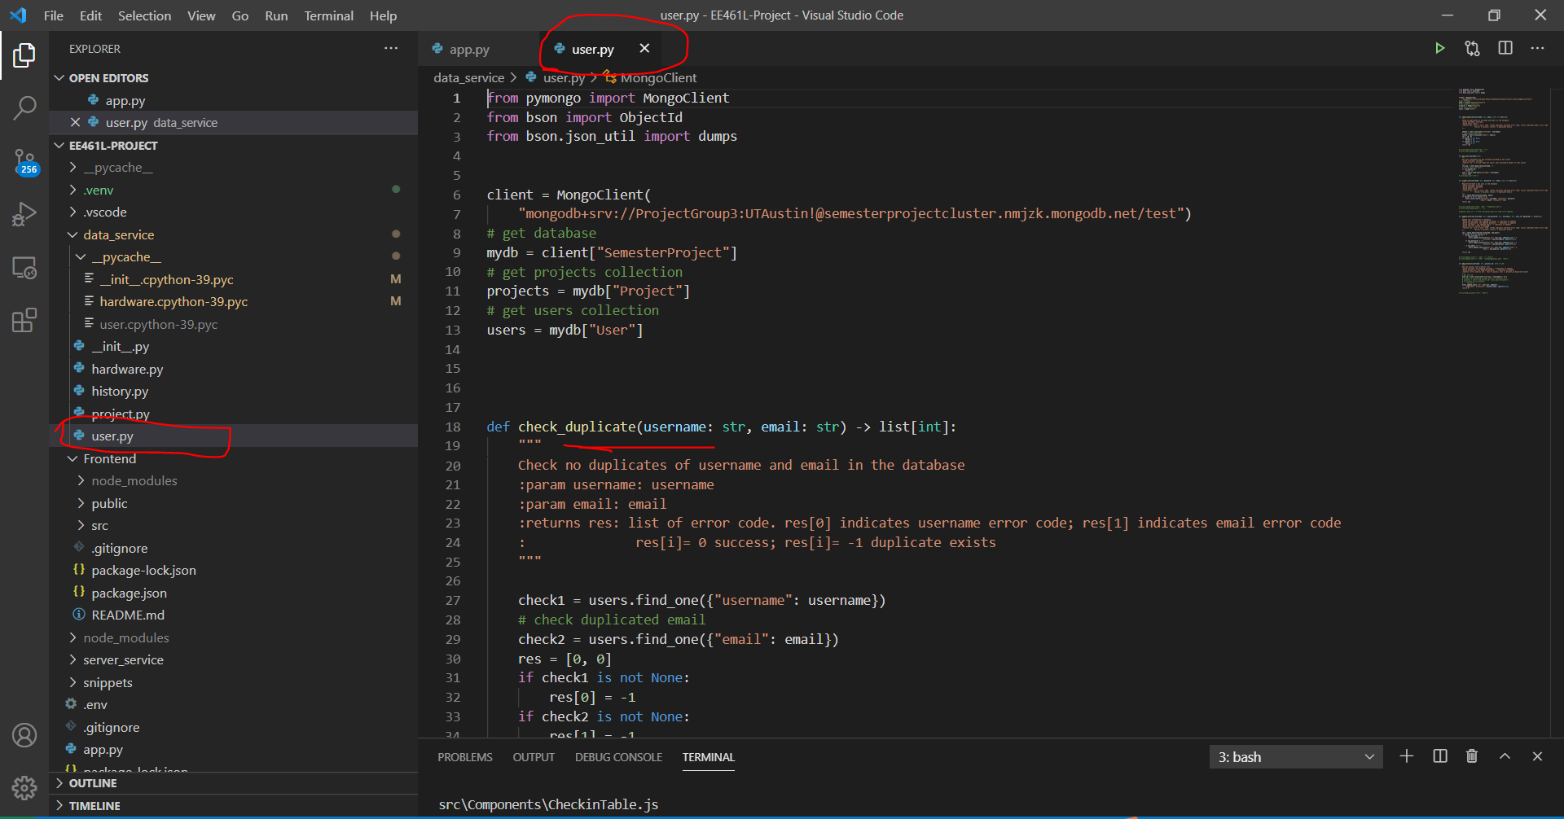
How Flask can modify the mongoDB data
In app.py, import the *.py file from the ‘data_service’ package, in which the backend people wrote methods to modify/read the data we have in mongoDB database. By calling those methods we can modify the mongoDB data.

Slide 7
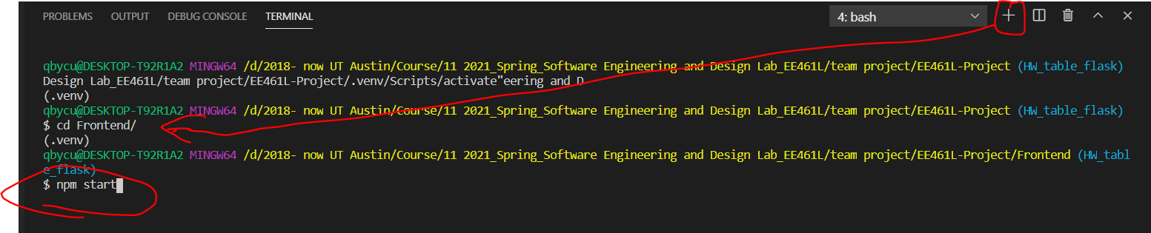
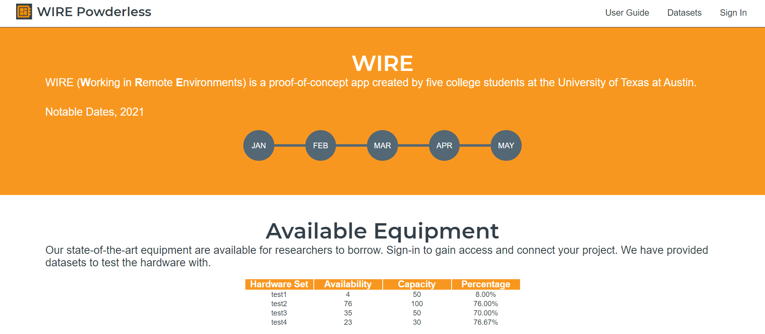
Run reactJS
Create a new terminal to run react JS(don’t terminate the one which is running flask);
Under ‘EE461L-Project/Frontend’ folder, do ‘npm start’

Slide 8
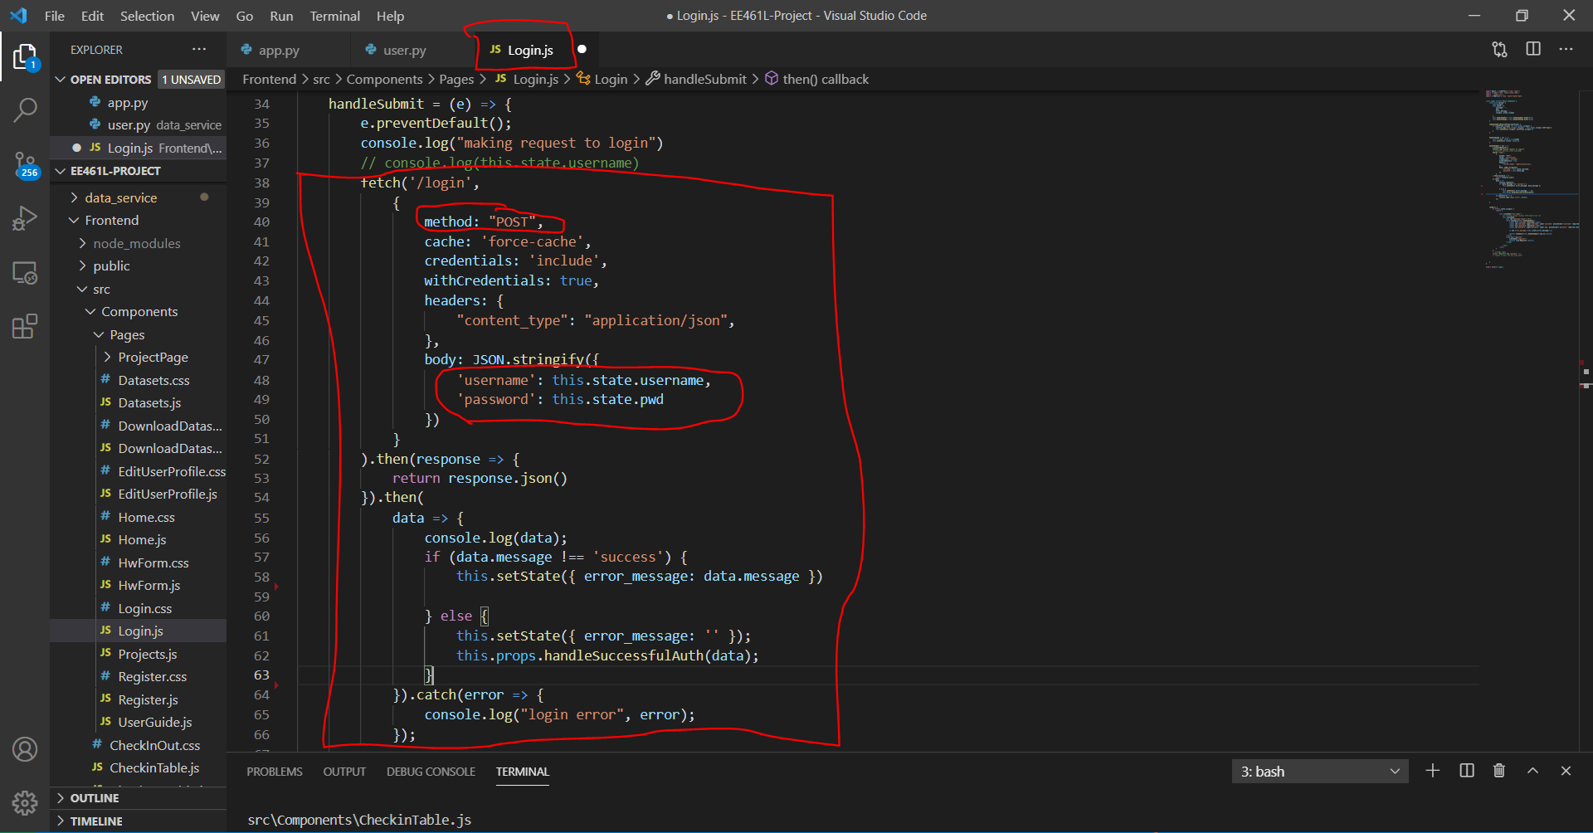
Take the Login feature as an example
Send data from ReactJS -> Flask:
When we would like to submit our ‘username’, ‘password’, information
If you’re going to get response from flask without sending data from reactJS,
Here the method type should be ‘GET’. A good example is in App.js

Slide 9
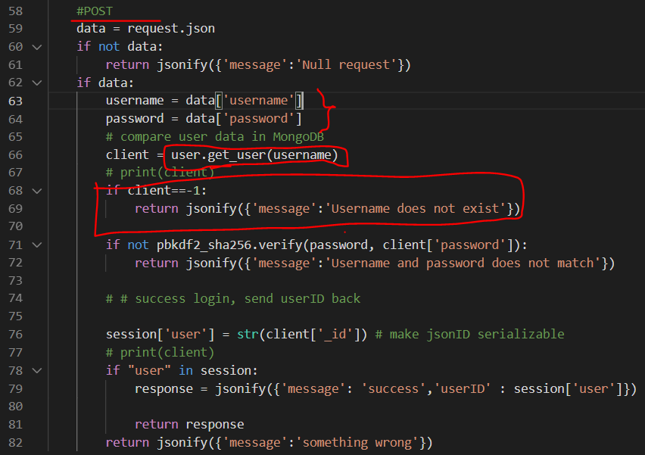
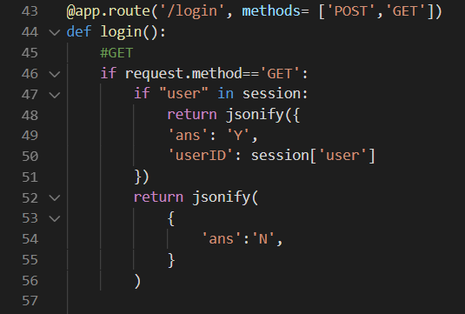
Take the Login feature as an example
Send data from ReactJS -> Flask:
When we would like to submit our ‘username’, ‘password’, information.
At the same time, wrote code in flask to handle the case when the method is ‘POST’:

Slide 10
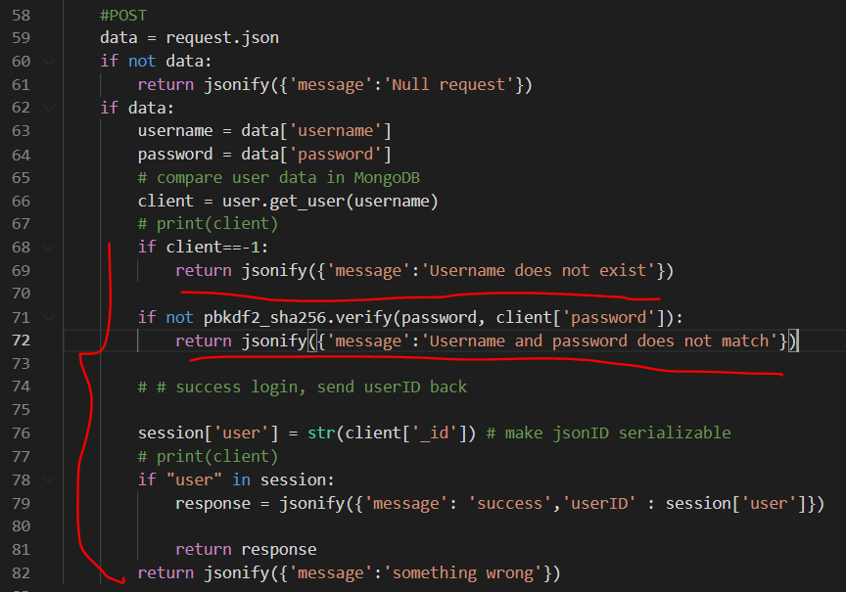
Send data from Flask -> ReactJS
In the login example, when we would like to know if a guest can successfully login:
Return different response in the json file
format

Slide 11
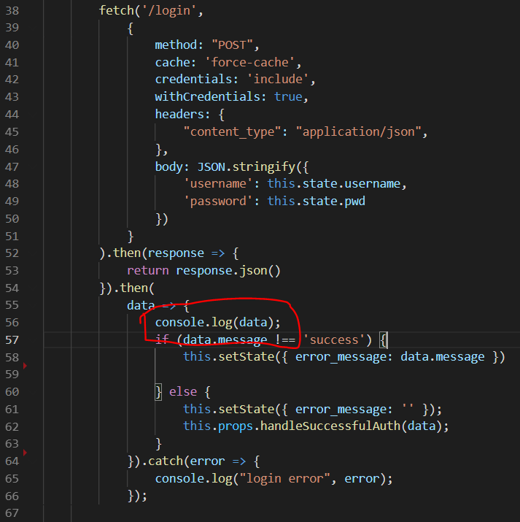
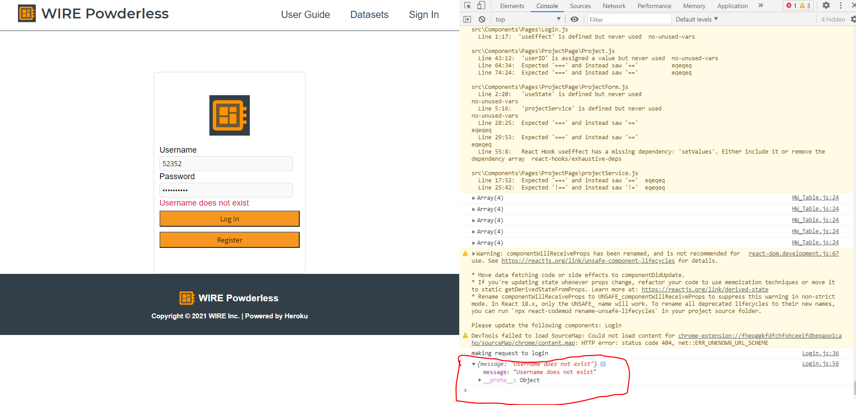
How to check data is successfully sent from flask to reactJS
Use ‘console.log(data)’; in browser, do ‘inspect’-> click ‘console’

Slide 12
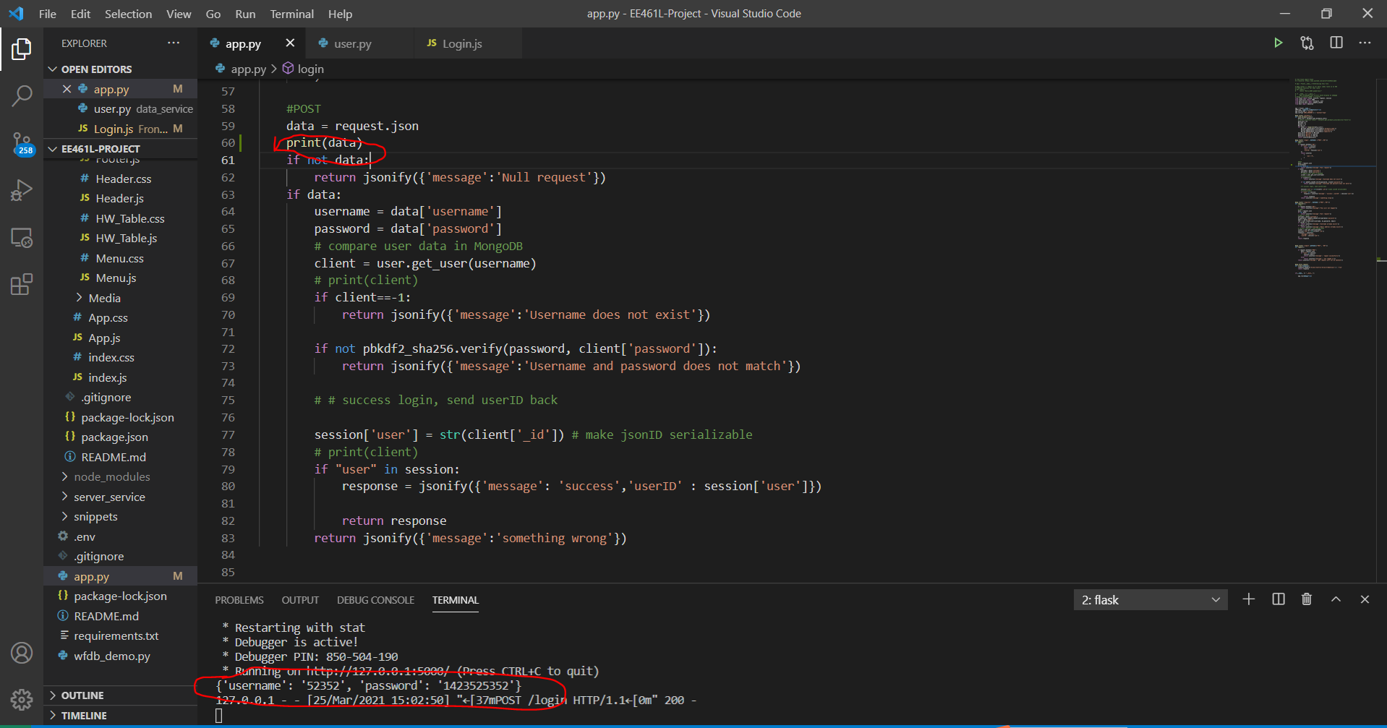
How to check data is successfully sent from reactJS to flask
Print the request in the terminal

Slide 13
How to access mongoDB
Group Email: username: ee461lprojectgroup3@gmail.com password: UTAustin! MongoDB account: email: ee461lprojectgroup3@gmail.com password: UTAustin! You'll need to add your IP address to the access list

Slide 14
User: user.py
user_id
username
password
Email
[project_id]
Project : project.py
project_id
project_name
status: ongoing / completed
Date_created
Last_edited
comment
Hw_set_dict :{HWSet_id_1: 5,
HWSet_id_2 :5 }
user_id
team: [user_id]
=====Phase 3======
Total Credit:
HardwareSet: hardware.py
Hardware_set_id
HWSet_name
capacity
availability

Slide 15
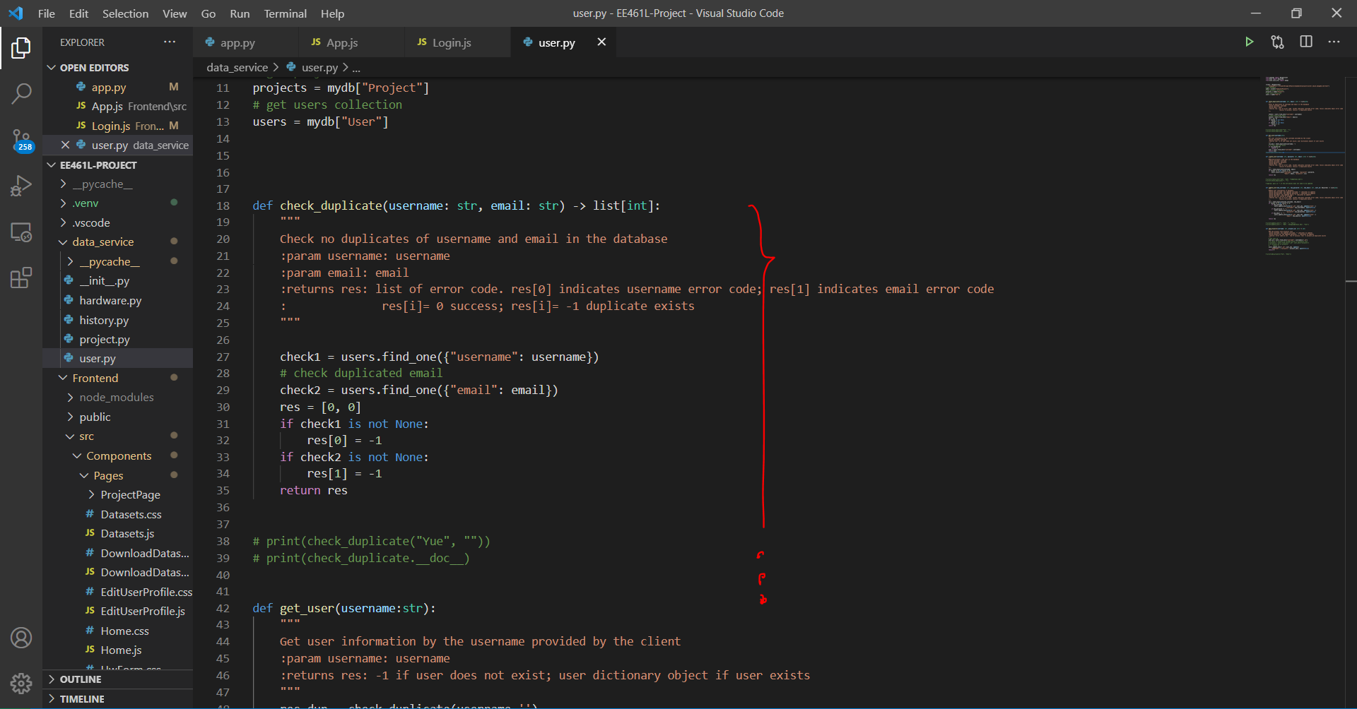
How can the ‘*.py’ files in the data_service package modify the data in mongoDB

Slide 16
How the login/logout status is synchronized
Reference: https://www.youtube.com/watch?v=zSt5G3s3OJI
Flask has ‘session’ object(similar to a dictionary) to record the login status for each client
App.js send a ‘get’ request to ask for the login status
Sending the login status props from App.js to child component:
All the child component is rendered with respect to the login status passed by props from App.js
4. Updating the login status from child component to parent component(App.js):
- Passing a function as props from App.js to child component

Slide 17
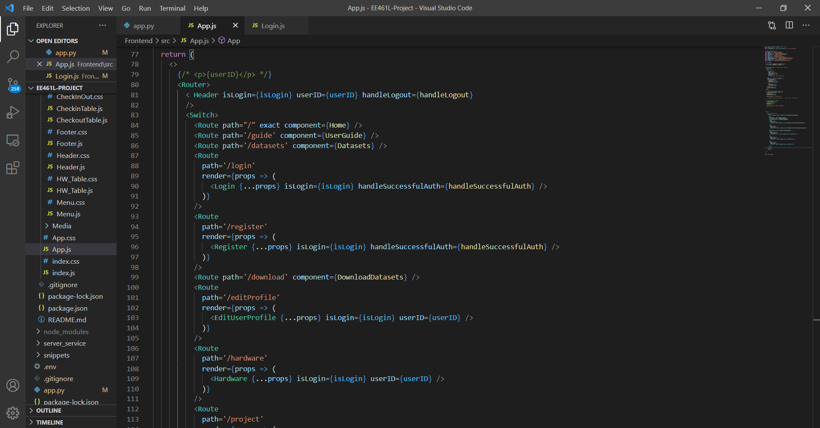
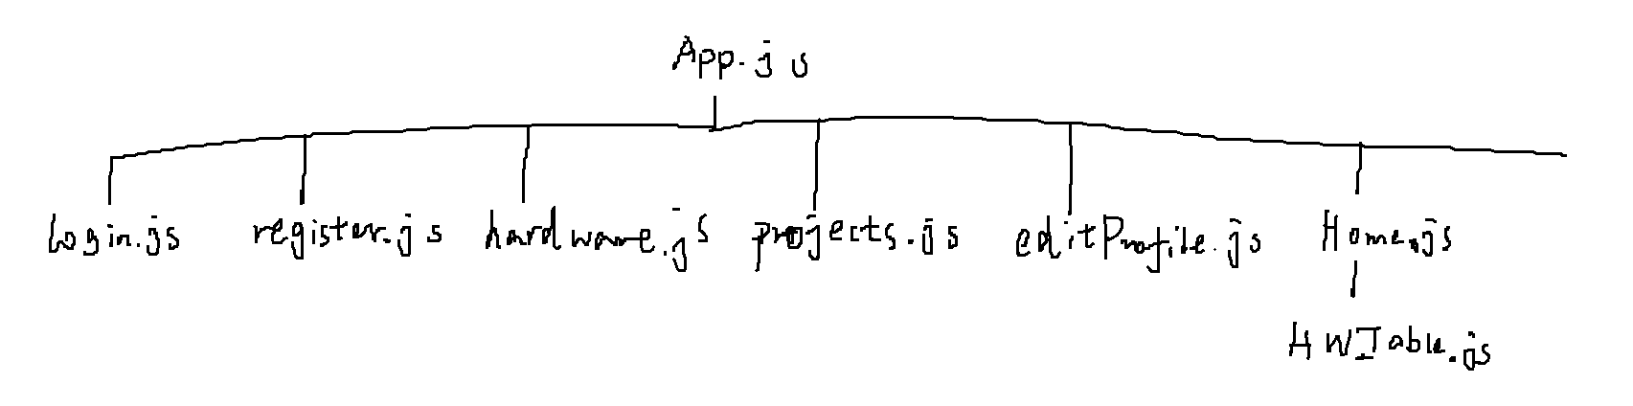
Hierarchy:

Slide 18
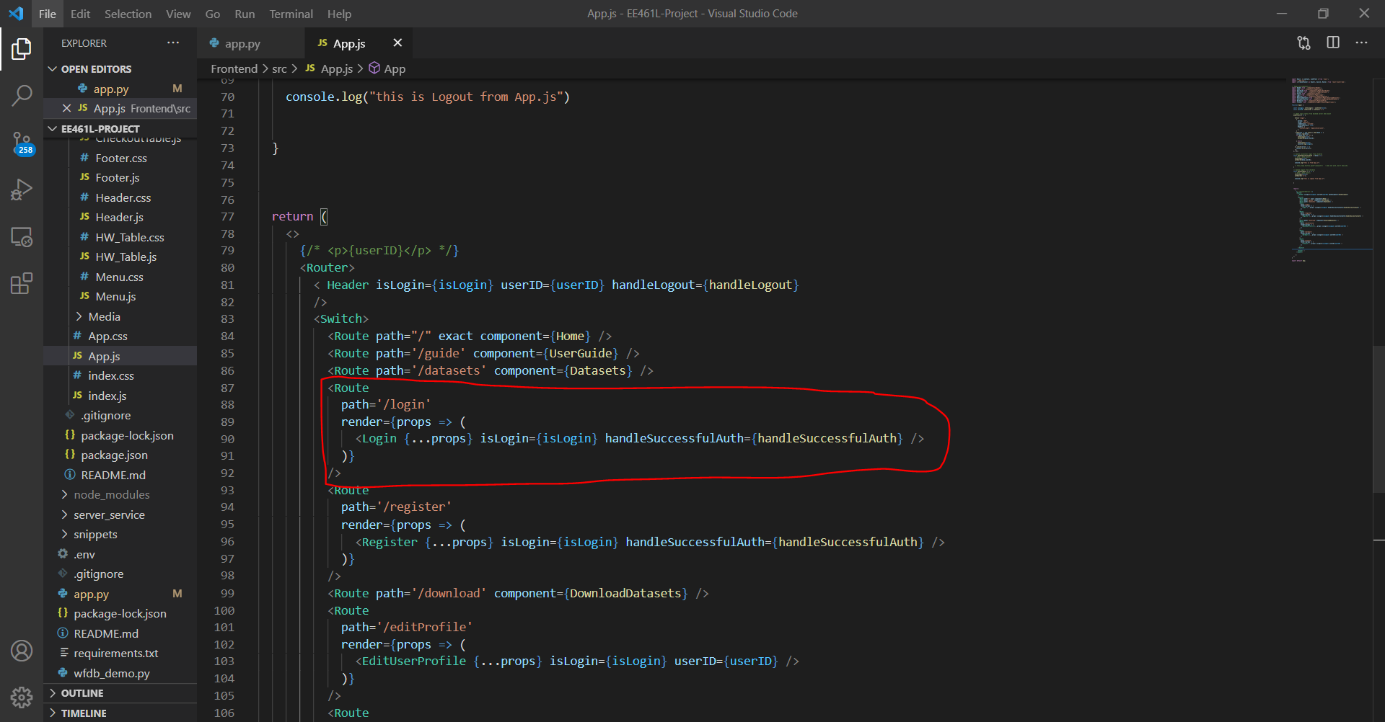
From parent to child: In App.js

Slide 19
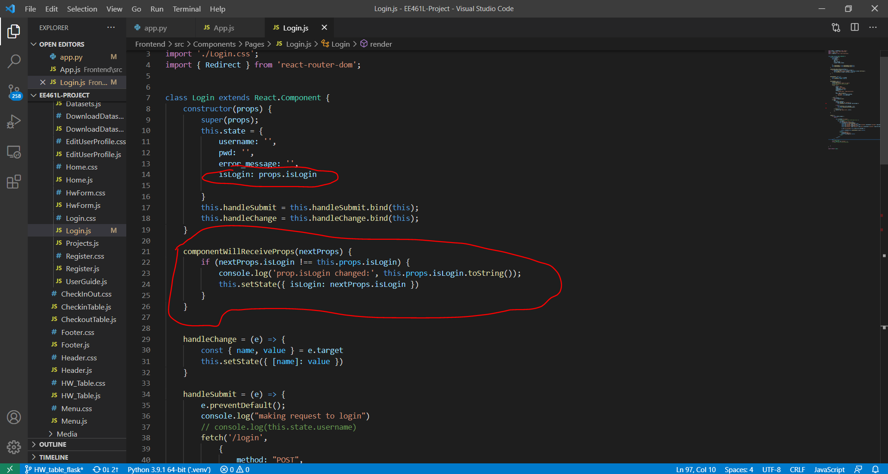
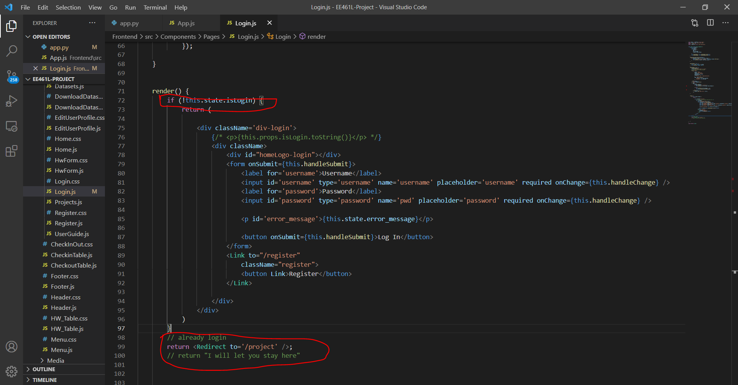
From parent to child: In Login.js, do conditional rendering

Slide 20
From child to update parent’s state value: - Passing a function as props from App.js to child component

